Slide 1
Learning to Program in Python
Concept 1
Variables
(and operators)
Notes:
Variables will have been used in the starter program.
This is a full introduction to variables and data types, and a second lesson (this resource) introduces operators.
The tasks and ideas would require several classes to ensure students have time to engage with the concept.

Slide 2

Learning Intentions
From this lesson the students will be able to:
  Solve a numerical task and program their solution.
Notes:
This lesson is completely problem based, with students expected to discover the answers to the etasksheets themselves .
The numerical task is really the first major computational thinking challenge for the students that is expected to be coded.
A bigger CT challenge, presented via HTML, on the conversion of hours minutes seconds is aligned to this lesson on the website.

Slide 3

Create Your Own … Number Buster
Your task is to write a program that will extract each digit of a 2 digit number.
The user will enter a 2 digit number such as 45 or 71.
Using operators you have learned, output the first digit and the second digit of the number.
User Interface
Your program will prompt the user for the 2 digit number.
Your program will clearly output the first digit and second digit of the number.
When completed, test your program with 90, 44, 19, 91, 10.
LO 1.3 students should be able to solve problems by deconstructing them into smaller units using a systematic approach in an iterative fashion
Notes:
This challenge forms part of the student etasksheet 1.2. Students must write the algorithm first. The next slide shows some suggestions on how to code this problem.
Encourage students, in paired programming style, to verify each other’s code and test for bugs and logical errors.
Encourage students to write out their algorithms, and to use pseudo code.
The Scratch symbol indicates that this task should also be done in Scratch (or similar block-based language). The html resource, containing the Scratch program and guiding the students, is part of the same folder as this Python resource. (see While loops for an extension to this challenge). Encourage the students to edit the html file to serve as part of an ePortfolio. See the file for instructions.

Slide 4
Some suggestions for your program
1. Some names to consider for the variables …
userNumber, firstDigit, secondDigit.
2. Remember this code from the first program?
In Python, input from the user is in the form a STRING.
The variable userNumber must be cast as an INTeger.
3. A suggestion for outputting the solution :
print(“The first digit is : “, firstDigit)
Notes:
Encourage good habits from the start, such as using variables appropriately and appropriately named.
There are a multitude of style guides online such as http://www.cs.bu.edu/courses/cs108/guides/style.html.
The user interface should be considered up front as part of the solution.

Slide 5
Tips on separating digits in a number
Let’s say our number is called userNumber.
Let userNumber equal 73
If we MOD userNumber by 10, we get the remainder.
Try 73 % 10.
If we FLOOR DIVIDE userNumber by 10, we get a whole number.
Try 73 // 10.
LO 1.4 students should be able to solve problems using skills of logic
Notes:
The reason we use 10 is because the numbers are decimal.
Remind students that instead of 73 // 10 we can equally use int( 73 / 10).
When students study LOOPS they will be able to offer the user unlimited amount of turns plus the option to exit the program.
Also later in the course, students could test their program by programming every input from 00 to 99, again using LOOPS.

Slide 6
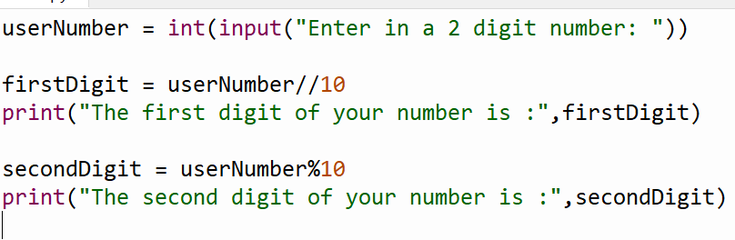
To Recap … Number Buster
LO 1.7 students should be able to develop algorithms to implement chosen solutions
Notes:
This challenge forms part of the student tasksheet 1.2. Students must write the algorithm first. The next slide shows some suggestions on how to code this problem.
Encourage students, in paired programming style, to verify each other’s code and test for bugs and logical errors.
Encourage students to write out their algorithms, and to use pseudo code where possible.
When students study LOOPS they will be able to offer the user unlimited amount of turns plus the option to exit the program.
Also later in the course, students will be asked to test their program by programming every input from 00 to 99, again using LOOPS.

Slide 7
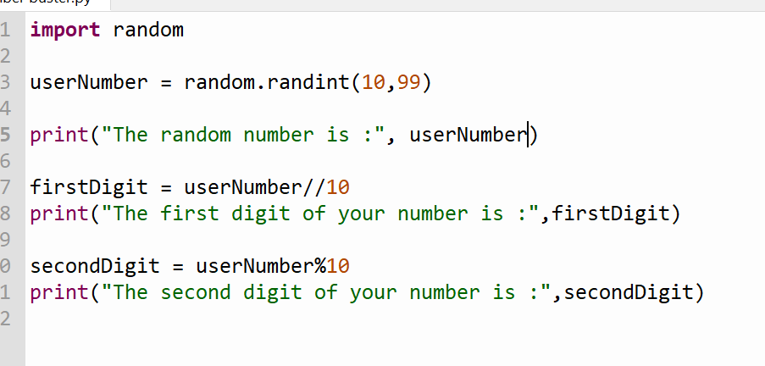
To Recap … Number Buster
LO 1.7 students should be able to develop algorithms to implement chosen solutions
Notes:
This challenge forms part of the student tasksheet 1.2. Students must write the algorithm first. The next slide shows some suggestions on how to code this problem.
Encourage students, in paired programming style, to verify each other’s code and test for bugs and logical errors.
Encourage students to write out their algorithms, and to use pseudo code where possible.
When students study LOOPS they will be able to offer the user unlimited amount of turns plus the option to exit the program.
Also later in the course, students will be asked to test their program by programming every input from 00 to 99, again using LOOPS.

Slide 8

Create Your Own …
3 digit Number Buster
Can you enhance your program to extract each digit from a 3 digit number?
The user will enter a 3 digit number such as 545 or 708.
Using operators you have learned, output the first digit, the second digit and third digit of the number.
Generate a random 3 digit number to test your code.
LO 1.20 students should be able to collaborate and assign roles and responsibilities within a team to tackle a computing task
Notes:
Some students may progress to this slightly more difficult challenge. Or it could be set as a class task or home challenge.
Preferably, a task of this nature is the ideal opportunity for a collaborative and shared task approach between small groups of students.
The fist major Computational Thinking challenge, presented via HTML, on the conversion of seconds to hours minutes seconds is aligned to this lesson on the website.

Slide 9
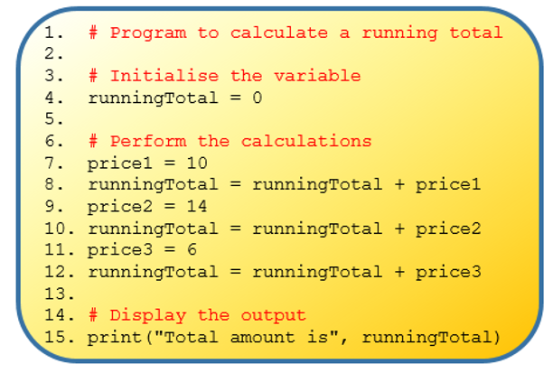
Running Total

Slide 10
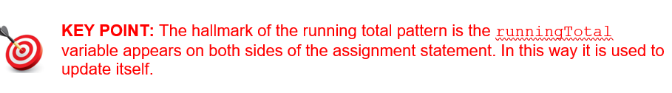
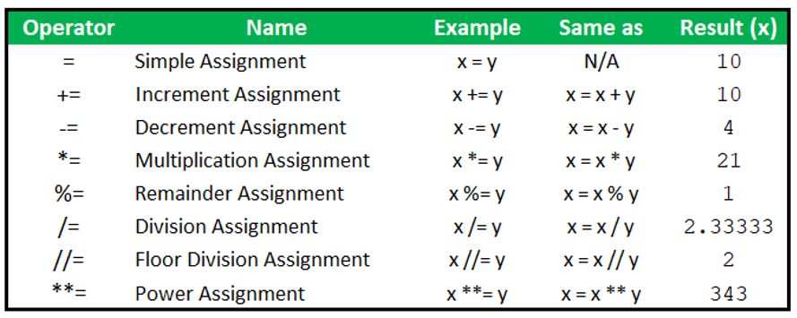
Running Total

Slide 11
Learning to Program in Python
Concept 3
STRINGS
Notes:
Strings are a form of data type.
The main Learning Outcomes (LO) achieved are highlighted throughout the lesson and tasks.
The list is not exhaustive, and consultation with the LCCS spec is encouraged at all times throughout the implementation of the course.

Slide 12
Learning Intentions
From this lesson the students will be able to:
  Understand the concept of a string
  Retrieve and Replace characters in strings
  Slice a string into sub-strings
  Write strings to a file
LO 2.16 students should be able to use data types that are common to procedural high-level languages
Notes:
The skills learned to analyse and create strings will serve the students well for conditional statements and also for learning lists.

Slide 13

STRINGS
Our very first line of code we wrote in the IDE was:
“hello world” is an example of a string.
You can enclose it in single quotes also.
(‘hello world’)
Notes:
Link to very first use of python in class. Encourage use of double quotes.

Slide 14
STRINGS
A string is a data type.
Each individual member of a string is a character such as “A” or “1” or “!” or “ “.
(These characters are in fact strings of length 1)
Notes:
Emphasise the first index is ZERO and strings are a form of data type ….. Very popular type in Python

Slide 15
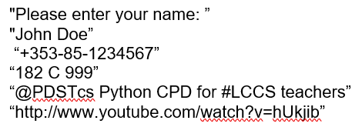
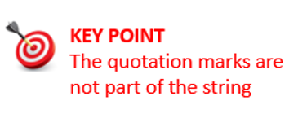
Strings

Slide 16

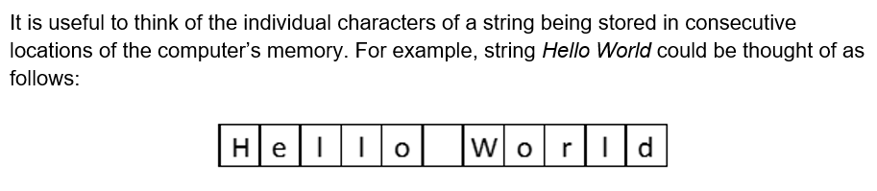
Strings

Slide 17
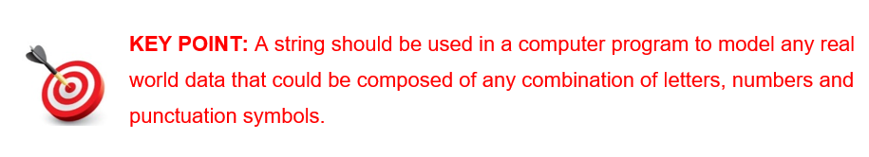
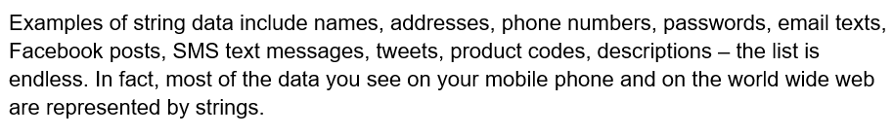
When to use a strings

Slide 18
Learning Intentions
From this lesson the students will be able to:
  Understand the concept of a string
  Retrieve and Replace characters in strings
  Slice a string into sub-strings
  Write strings to a file
LO 2.16 students should be able to use data types that are common to procedural high-level languages
Notes:
The skills learned to analyse and create strings will serve the students well for conditional statements and also for learning lists.

Slide 19
STRINGS
The characters can be accessed by their index or place in the string.
The first index is ZERO
Notes:
Emphasise the first index is ZERO and strings are a form of data type ….. All basic input and output in Python is in the form of strings

Slide 20
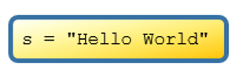
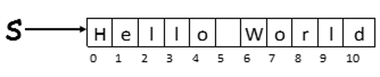
String Indexing
The index position of every character in string s

Slide 21
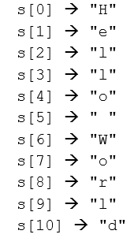
String Indexing

Slide 22
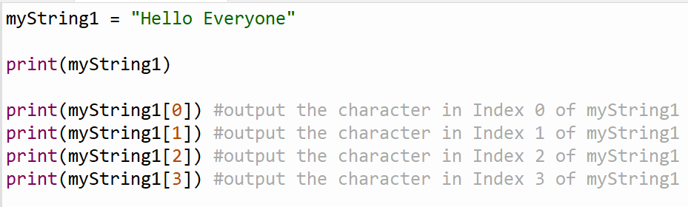
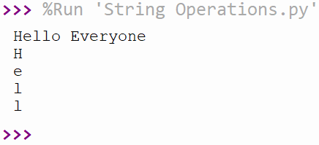
String Indexing
The Output from the Program

Slide 23
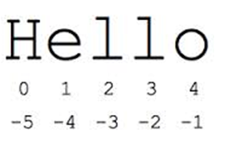
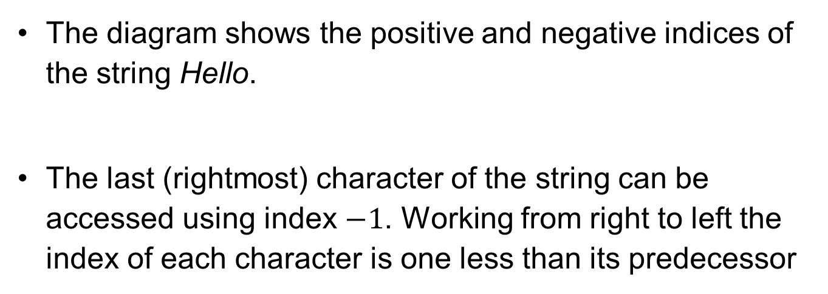
Negative Indexing
The diagram shows the positive and negative indices of the string Hello.
The last (rightmost) character of the string can be accessed using index $−1$. Working from right to left the index of each character is one less than its predecessor

Slide 24


Common Pitfalls with strings
Once a string is initialised (given a value) it can not be changed
The index value is too big

Slide 25
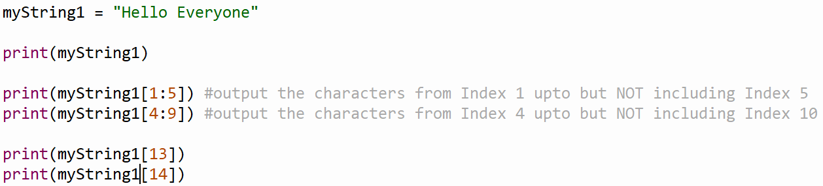
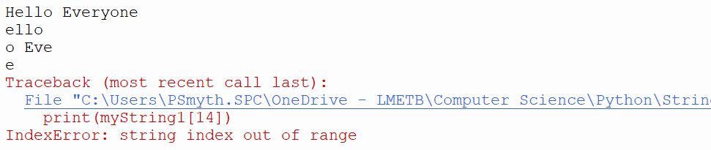
String Slicing (substrings)
The Output from the Program

Slide 26
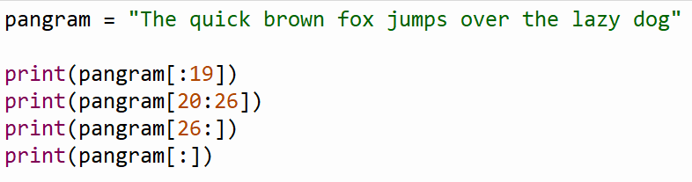
String Slicing

Slide 27
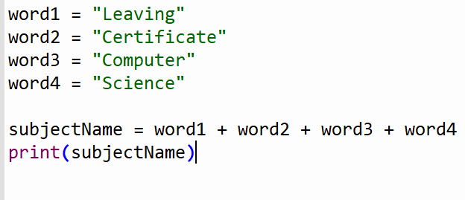
String Addition
The plus operator, + , is used to join two strings together. This is known as concatenation

Slide 28
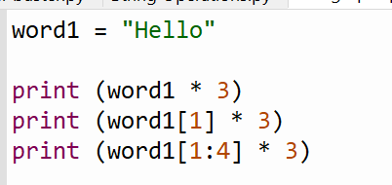
String Multiplication

Slide 29
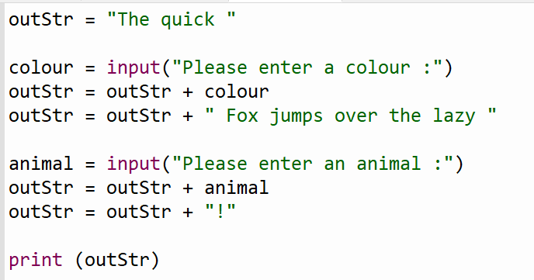
Building Up a String

Slide 30
Learning Intentions – 27/09
From this lesson the students will be able to:
  From upper to lower case and vice versa
  Get the length of string
LO 2.16 students should be able to use data types that are common to procedural high-level languages
Notes:
The skills learned to analyse and create strings will serve the students well for conditional statements and also for learning lists.

Slide 31
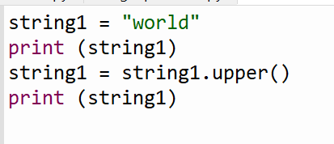
From lower to upper case

Slide 32
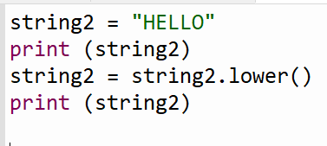
From upper to lower case

Slide 33
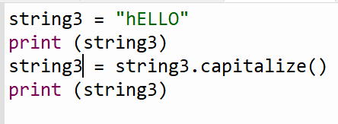
Capitalise the 1st letter and the rest to lower

Slide 34
Escape Characters( \ )
Remember : If we want to print a string and then on the next line print another string we use the backslash followed by the letter n.
print(“First Line.\nSecond Line.”)
(backslash (\) is known as an escape character in Python)
Notes:
Encourage the students to experiment and continue to research the Python Docs -> Tutorial -> Strings

Slide 35
Escape Characters( \ )
“\t” Inserts a tab for example
“\”” The backslash here escapes the quotes and so this would print out a set of quotes.
(See the Strings section in Python Docs Tutorials.)
Notes:
Encourage the students to experiment and continue to research the Python Docs -> Tutorial -> Strings

Slide 36
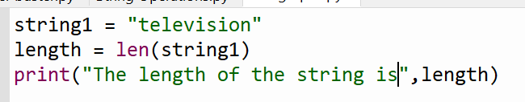
Find the length of a string

Slide 37
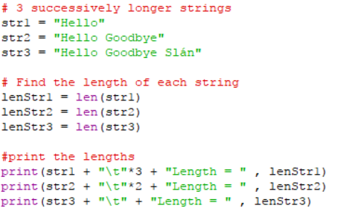
Length of a String (Len)
A very useful function in programming is finding the Length of a string. Try the code below.
LO 1.22 students should be able to read, write, test, and modify computer programs
Notes:
Encourage the students to type in this code, save in a file in their storage space, and edit and experiment

Slide 38
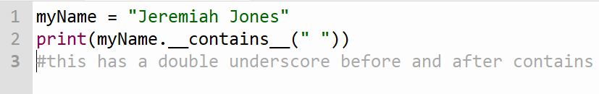
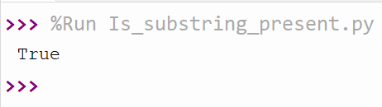
To find if a substring is present
The output is a Boolean value -> True or False

Slide 39
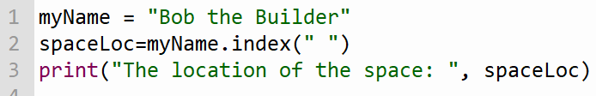
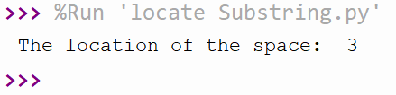
To locate a substring
The output is the index value. If the item occurs more than once, the .index() function only returns the first index number

Slide 40
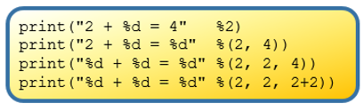
String Formatting
Sometimes it is useful to be able to display a string that is made up of several pieces of data without having to use the string construction techniques already described.
Formatting string expressions enable us to display more than one piece of data ina single string print statement.

Slide 41

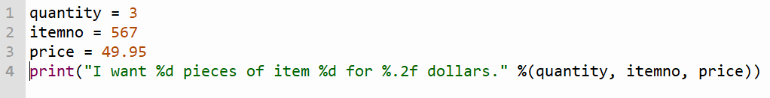
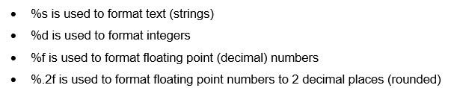
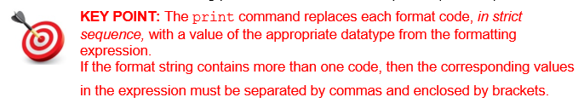
String Formatting Examples

Slide 42
Use String Formatting to make this program more efficient

Slide 43
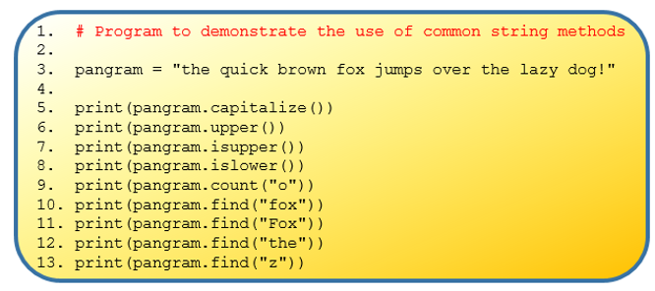
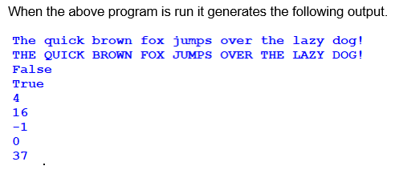
Python has lots of built-in methods that you can use on strings.

Slide 44
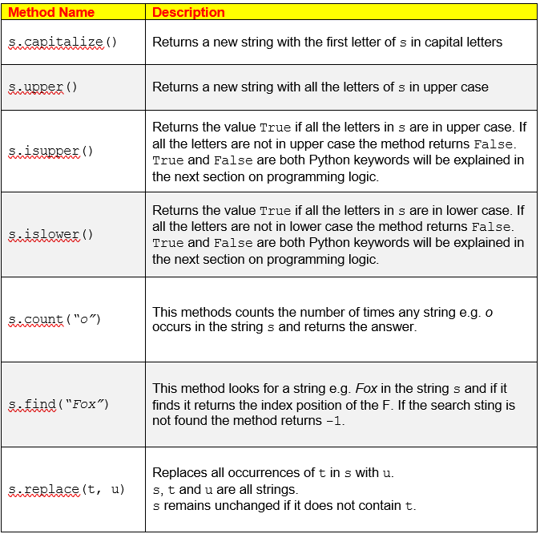
Other string methods
Python has lots of built-in methods that you can use on strings.

Slide 45
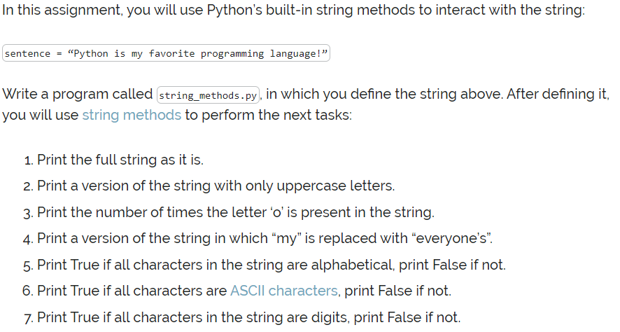
Practice string methods

Slide 46
a = ‘Happy’ b = ‘Birthday’
+ | Concatenation | a + b gives ‘HappyBirthday’
* | Repetition | a * 3 gives ‘HappyHappyHappy’
[] | Slice | b[1] gives ‘i’
[:] | Range Slice | a[:2] + b[5:] gives ‘Haday’
= | Assignment | c = b gives c =‘Birthday’ and c is separate from b.
+= | Assignment & concatenation | c += ‘ Boy’ gives c as ‘Birthday Boy’
in | Membership | ‘p’ in a gives True (or 1) ‘q’ in a gives False (or 0)
False
‘t’ in a gives ?
Notes:
The word descriptions of the operations are important. (Slice, Concatenation, Assignment, etc….)
Encourage students to predict the outcomes. The PRIMM method will encourage engagement. (Predict Run Investigate Modify Make)
The assignment and concat are useful for the solution to the next challenge.

Slide 47
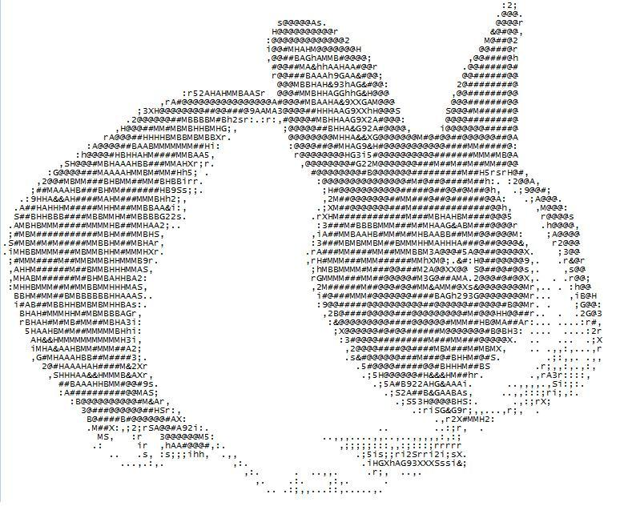
The ASCII Alphanumeric Code
What is it?
Why use it?
How do we use it?

Slide 48
What is it?
Computers work with digital signals, consisting of either 1’s or 0’s. We need some way to encode numbers, letters and symbols in binary. One of the most commonly used binary codes is the ASCII code.
ASCII stands for “American Standard Code for Information Interchange” and was developed in the 1963.
ASCII code includes all the uppercase & lowercase characters on the keyboard, the numbers and most of the other characters (!, +, %, etc). Non-printable characters such as blank spaces are also included.
Notes:
The control characters in ASCII still in common use include:
0 (null, NUL, \0, ^@), originally intended to be an ignored character, but now used by many programming languages to mark the end of a string.
7 (bell, BEL, \a, ^G), which may cause the device receiving it to emit a warning of some kind (usually audible).
8 (backspace, BS, \b, ^H), used either to erase the last character printed or to overprint it.
9 (horizontal tab, HT, \t, ^I), moves the printing position some spaces to the right.
10 (line feed, LF, \n, ^J), used as the end of line marker in most UNIX systems and variants.
12 (form feed, FF, \f, ^L), to cause a printer to eject paper to the top of the next page, or a video terminal to clear the screen.
13 (carriage return, CR, \r, ^M), used as the end of line marker in Mac OS, OS-9, FLEX (and variants). A carriage return/line feed pair is used by CP/M-80 and its derivatives including DOS and Windows, and by Application Layer protocols such as HTTP.
27 (escape, ESC, \e [GCC only], ^[).
127 (delete, DEL, ^?), originally intended to be an ignored character, but now used in some systems to erase a character.

Slide 49
Why do we use it?
Before ASCII, many different character sets were used, so on one system the code 0100001 would represent A, but on another it could be P, or Y!!!
A standardised system was needed, resulting in the creation of ASCII.
ASCII (and later Unicode) are important as they provide a standard way for computers to represent characters that are readable by other computers (when encoded) as well as people (when decoded). This allows different computer systems to communicate with each other, ensuring their outputs are consistent with each other.

Slide 50
Why do we use it?
Obviously this situation was far from ideal.
A standard character set was needed so that consistency between systems could be achieved.
Almost all character sets in use, now begin with the 128 ASCII characters.

Slide 51
How do we use it?
Each character is represented as a decimal value from 0 to 127.
This number is then converted to a binary code, (a sequence of binary digits, called bits) A bit can be either 1 or a 0.
The ASCII code for a character usually consists of 1 byte (8 bits)

Slide 52
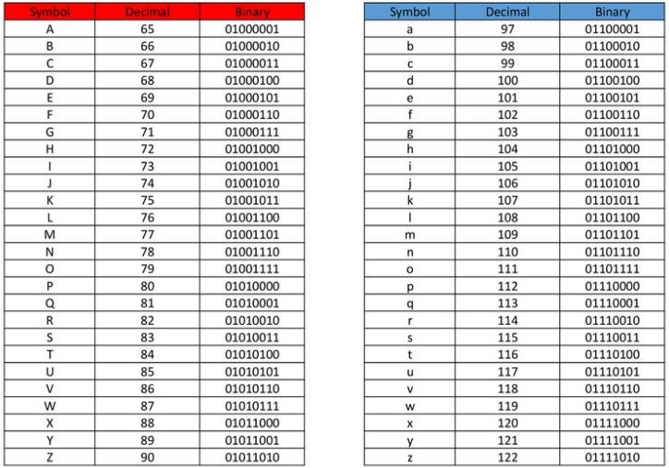
Extract from ASCII table
Notes:
Numbers can be encoded, but are stored as a text character (like a string in a database), so can not be used in calculations.

Slide 53
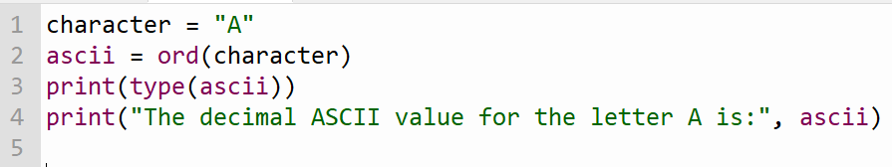
Getting the decimal ASCII value of a character
The ord() function takes a character and returns the ASCII decimal value for that character

Slide 54
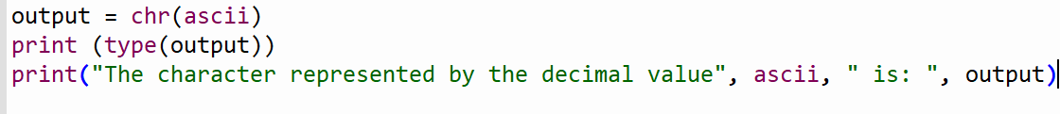
Converting a decimal ASCII value to a character
The chr() function takes ASCII decimal value and converts it to the character that it represents
The two built-in functions – ord and chr - are used to convert back and forth between characters and ASCII decimal values.

Slide 55
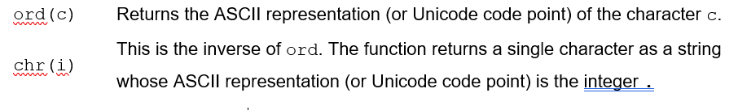
ord / chr
Practice using ord() and chr() to convert the following values to ASCII decimal values and back again :
E, 2, &, @
Understanding ASCII and Unicode
https://www.youtube.com/watch?v=5aJKKgSEUnY

Slide 56
Basic Encryption Example
Encryption is the process of encoding information for security purposes.
A very basic encryption is to take the ASCII values of the characters and “shift” each character using a “key”
If the key was +3 and we want to encrypt C
  Get the ASCII value of C which is 67
  Shift 67 by +3, this gives us 70
  Convert the ASCII value back to a character => F
  The encrypted value of C is F

Slide 57
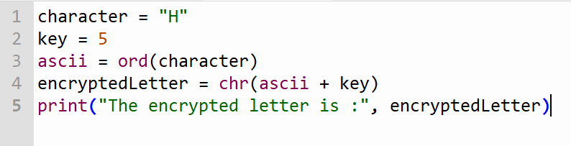
Encryption Example – Caesar Shift
This type of encryption is known as the Caesar shift. Named after Julius Caesar who supposedly used it to send messages during his military campaigns. IT IS NOT A SECURE ENCRYPTION because the frequency of the letter pattern provides a big clue in deciphering the entire message. The most commonly used letters of the English language are e, t, a, i, o, n, s, h, and r. The letters that are most commonly found at the beginning of words are t, a, o, d, and w

Slide 58
Encryption Question
Write a program that encrypts a word using a Caesar shift. The program requires the word and the shift key (0 – 25) as input. A word must consist of 5 letters in lower case with no spaces. The output of the word is the encrypted word.
EXAMPLE
Input: hello
Key: 5
Output: mjqqt

Slide 59
Unicode (Universal Character Set)
ASCII was based on the Roman character set that English and most European languages use.
There are many languages in the world that use non-roman character sets such as Russian, Chinese and Urdu. These languages all have their own character sets with different kinds of characters.
Unicode was developed to allow for representation of a wide variety of characters including those from all the major languages and many other symbols, including emojis.

Slide 60
Unicode (Universal Character Set)
The first 128 characters of the Unicode are exactly the same as ASCII. Unicode then continues on with codes for over a million different characters. It is being extended regularly and is used throughout the world.
Unicode contains many more characters than ASCII and therefore requires much more space, resulting in higher memory requirements as well as larger transmissions when sent. If Unicode was to use four bytes (32 bits) to represent each character, a lot more space would be taken up needlessly.
UTF-8 encoding provides a solution for this.

Slide 61
UTF-8
UTF-8 stands for “Universal Transformation Format”. The “8” means that it uses 8-bit blocks to represent a character.
UTF-8 is a method for encoding Unicode characters and it is the main encoding method used for this on the internet.
UTF-8 converts a code point (which represents a single character in Unicode) into a set of one to four bytes. The first 128 characters in the Unicode library — the characters we saw in ASCII — are represented as one byte. Characters that appear later in the Unicode library are encoded as two-byte, three-byte, and eventually four-byte binary units.

Slide 62
UTF-8
On the following slide is a Unicode character table with the UTF-8 output for each character added. Notice how some characters are represented as just one byte, while others use more.

Slide 63
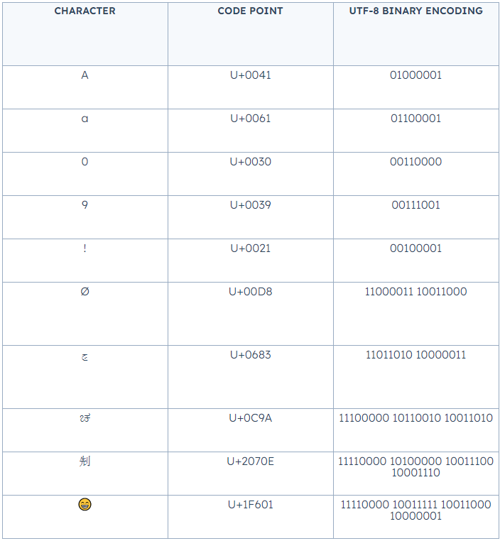
Unicode (Universal Character Set)

